Slide 1

Supporting Students with Depression:
A Practical Guide for Teachers
2025-07-28 Hsiang-Chen Yeh

Slide 2

CONTENTS
💡 Why Early Recognition of Depression in Schools Matters
🧩 Evidence-Based Strategies to Support Students with Depression
🗣️ Action Sentence Starters for Daily Classroom Use
🎞 Video Library

Slide 3

01
💡 Why Early Recognition of Depression in Schools Matters

Slide 4
💡
Why Early Recognition of Depression in Schools Matters 1/2
Children and adolescents often show different symptoms than adults.
Depression may appear as irritability, fatigue, somatic complaints (like stomachaches), or withdrawal—not necessarily sadness.
Untreated depression can impair academic performance.
Youth with depression often have difficulty concentrating, lower grades, and are more likely to miss school.
Depression in youth is linked to long-term mental health risks.
If unrecognized, childhood depression can increase the risk of persistent depressive disorder, substance abuse, and suicidal ideation in later years.

Slide 5
💡
Why Early Recognition of Depression in Schools Matters 2/2
Teachers are in a unique position to notice early warning signs.
As consistent adult figures in students’ lives, teachers can detect shifts in behavior, motivation, or peer interaction that may go unnoticed by others.
School-based interventions are effective.
Early recognition enables referral to school-based support programs, which have been shown to reduce depressive symptoms and prevent escalation.
Creating a supportive classroom environment helps all students.
Fostering emotional safety and connection can mitigate depressive symptoms, especially in marginalized or high-risk students.

Slide 6
💡
Understanding Childhood and Adolescent Depression
Depression in students often looks different than in adults. Teachers are often the first to notice these shifts in behavior, mood, or academic performance.
Symptom Type | In Children | In Adolescents
Emotion | Irritability, tearfulness, clinginess | Sadness, hopelessness, withdrawal
Cognition | Trouble focusing, self-blame, academic decline | Low self-esteem; hopelessness or a sense of meaninglessness; thoughts like “Nothing matters” or “What’s the point?”
Behavior | Sleep/appetite changes, stomachaches | Isolation, skipping class, self-harm
Language | “I’m tired,” “My tummy hurts” | “Nothing matters,” “I’m a failure”

Slide 7
💡
Your Role as a Teacher
You are not expected to diagnose or treat depression. However, you can be a:
Observer — Notice changes in mood, energy, participation.
Supporter — Provide a safe, compassionate space.
Connector — Refer students to school counselors or mental health professionals.

Slide 8
02
🧩 Evidence-Based Strategies to Support Students with Depression

Slide 9
🧩 Evidence-Based Strategies to Support Students with Depression
Strategy | What You Can Do | Why It Works
Emotional Expression & Processing | Assign structured expressive writing tasks (e.g., 15–20 mins/day for 3–4 days) where students write about personal stress or emotions | Improves mood and working memory in children; reduces depressive and anxiety symptoms (Fartoukh & Chanquoy, 2020; Pennebaker protocol) Teachers?
Create a Safe Writing Space | Allow ungraded, private journaling; emphasize confidentiality and emotional safety | Therapeutic journaling is a process of self-reflection and expression that supports emotional awareness, stress management, and healing (University of Wisconsin, 2020).
Foster School Connectedness | Build positive classroom climate, peer belonging, teacher-student trust, and encourage participation in school life | Strong sense of school connectedness is a protective factor against depression and anxiety (Raniti et al., 2022)
Identify and Support At-Risk Students | Watch for signs like withdrawal, frequent absences, low mood, or academic decline; offer quiet check-ins or referrals | Empathetic teacher engagement helps identify struggling students early (Gee et al., 2020)
Implement Selective Interventions | Use evidence-based programs (e.g., CBT-based FRIENDS) with students showing early signs of emotional distress | FRIENDS programs reduce anxiety and depressive symptoms effectively, especially when delivered by mental health professionals (Fisak et al., 2023)
Encourage Physical Activity | Promote regular physical movement (e.g., PE, walking, active breaks, or after-school sports, 3× per week) | Physical activity is linked to reduced depressive symptoms in adolescents, especially those over 13 (Recchia et al., 2023)
Collaborate with Counseling Resources | Partner with school counselors, mental health teams, and families to co-monitor and support students | Most students don’t seek help independently — school-based systems improve access (Gee et al., 2020)
Know Your Role — Support, Not Solve | Teachers are not therapists. Being a calm, supportive adult who listens, provides safety, and connects students to resources is already powerful and healing. | “Relationships are the agents of change and the most powerful therapy is human love.” — Dr. Bruce D. Perry, The Boy Who Was Raised as a Dog (2006)

Slide 10
Friends program- good strategies? Activities?
What schools can do?
How can teachers introduce physical activity into classroom
Sentence starters : how to bring up these topics
Goal setting? Motivated SMART goals
having hard time to start assignment
Promoting hope/ sense of agency
Resources: + websites

Slide 11
What Is “Wise Feedback”?
Wise feedback is a powerful teaching strategy that pairs high expectations with explicit reassurance and support. It tells students:
“I’m giving you this feedback because I know you’re capable of succeeding.”
This type of feedback is especially effective for students who may feel unsure if they belong—such as those affected by stereotype threat or self-doubt. When teachers express belief in a student’s potential and provide the support to reach it, it helps students:
Feel seen and respected
Stay motivated
Develop resilience and confidence
Why it matters:
Research (Cohen et al., 2006) shows that wise feedback improves performance, strengthens trust between teachers and students, and combats stereotype threat by affirming students’ value and ability.
1.Build Personal Connection
•Greet students by name
•Check in when they seem off
•Chat briefly about interests
Students feel seen and respected
(Goodenow, 1993)​

Slide 12
03
🗣️ Sentence Starters for Daily Classroom Use

Slide 13
🗣️
Sentence Starters for Daily Classroom Use
Context | Suggested Language
A student seems withdrawn | “I noticed you were quiet today—want to talk about it?”
Giving feedback | “I’m giving you this feedback because I know you can grow even more.”
After group work | “Thanks for being such a great teammate—your role really mattered.”
Addressing the class | “In our classroom, everyone’s voice and story matter.”
Discussing struggle | “Most students feel unsure at first. It doesn’t mean you don’t belong.”
Welcoming cultural sharing | “That tradition is so meaningful—thanks for sharing it with us.”

Slide 14
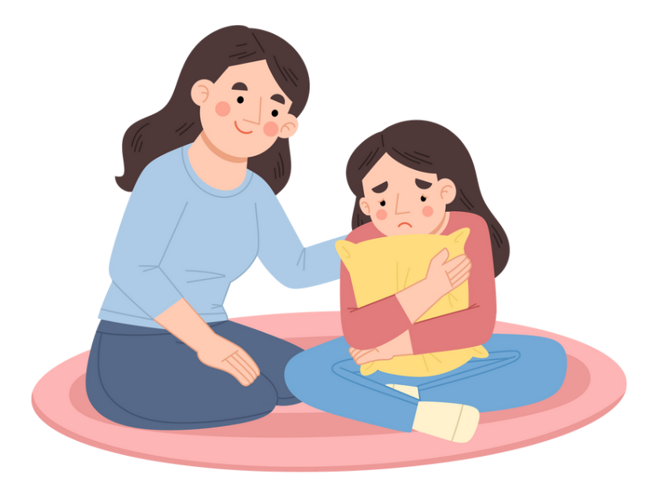
1. A student seems withdrawn
“I noticed you were quiet today—want to talk about it?”

Slide 15
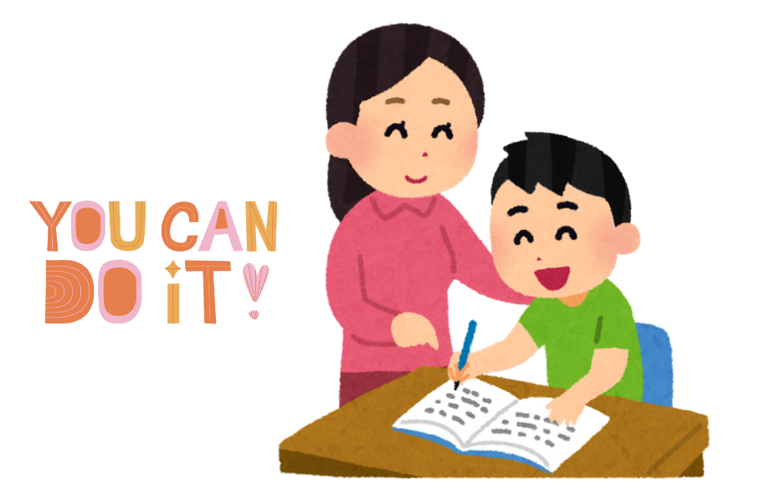
2. Giving feedback
“I’m giving you this feedback because I know you can grow even more.”
More Feedback Strategies That Show You Believe in Students: Six slides
1. Name the Strength First
“You explained your idea really clearly here — let’s see how we can add more details to make it even stronger.”
Starts with encouragement and builds momentum for improvement.
2. Be Specific, Not Generic
Instead of “Good job,” say:
“I like how you supported your opinion with an example from the story.”
Helps students know exactly what to keep doing and builds confidence.
3. Focus on Effort and Process
“I can tell you worked hard to organize your thoughts — let’s keep building on that.”
Reinforces a growth mindset and values persistence.
4. Invite Student Reflection
“How did you feel about this part? Where do you think you improved?”
Encourages ownership and deeper engagement with learning.
5. Connect to Progress Over Time
“Last month this was tough for you, but now look at how much clearer your writing is!”
Makes growth visible and motivates continued effort.
6. Use Encouraging Language for Mistakes
“Mistakes are part of learning — I’m glad you took a risk here. Let’s see how we can revise it.”
Normalizes struggle and reduces fear of failure.

Slide 16

3. After group work
“Thanks for being such a great teammate—your role really mattered.”

Slide 17

4. Addressing the class
“In our classroom, everyone’s voice and story matter.”

Slide 18
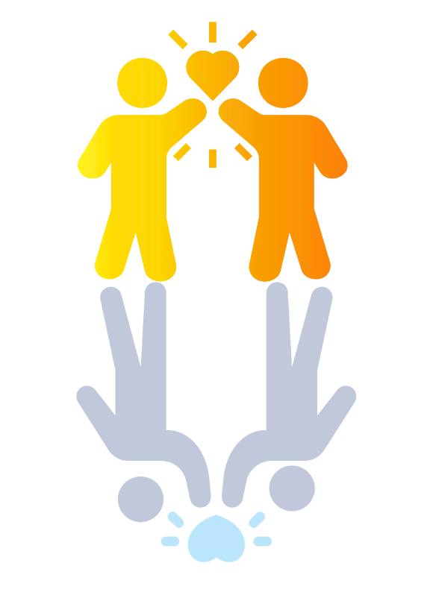
5. Normalizing Struggles in Peer Settings
“Most students feel unsure at first. It doesn’t mean you don’t belong.”

Slide 19

6. Welcoming cultural sharing
“That tradition is so meaningful—thanks for sharing it with us.”

Slide 20
04
🎞 Video Library
Family’s Videos | Teachers’ Videos | Teens’ Videos | Children’s Videos

Slide 21
Family’s Videos
For parents—to understand and support your child.
1.Promoting Child and Teen Mental Well-being
How families can support a child's mental health
A parent's perspective on children's mental illness
The Importance of Raising an Emotionally Intelligent Child
Raising Happy Teenagers
2. Resilience Building for Families
The seesaw effect: building children’s resilience by emotional regulation
3. Exploring Teen Career Paths
Questions Every Teenager Needs to Be Asked
4. Supporting Children and Teens with Depression
10 Ways to Help When Your Child is Depressed
Tackling Teenage Depression
How To Help Your Teen With Depression
5. Parenting a Suicidal Child or Teen
How Do I Parent My Suicidal Child/Teen?
6. Supporting Children with Anxiety
Children's Anxiety: 3 Ways to Help Your Anxious Child
How to raise kids who can overcome anxiety
7. Understanding and Connecting with Teens
What Teenagers Want You to Know
Be a better parent by partnering with your teen
How To Make A Shy Kid Confident
8. Helping Anxious Children: A 4-Part Parenting Guide
How to Help a Child With Anxiety: A Parent-Centered Approach to Managing Children’s Anxiety Part 1
How to Create Emotional Safety for a Child with Anxiety Part 2
Teach your kid to face their fears with scaffolding - Help anxious children part 3
12 Ways to Help A Child with Anxiety Part 4
10 Tips for Parenting Anxious Kids | Child Mind Institute

Slide 22
Teachers’ Videos
For teachers—to support student mental health and learning.
1. Building Resilience in the Classroom
How to build resilient children
2. Supporting Students with Anxiety and Depression
Classroom Strategies to Support Student Depression & Anxiety
Ask the experts: Depression in kids and how to help
Grounding Exercise to Manage Anxiety
3. Understanding and Supporting Students with ADHD
Strategies to Support Students with ADHD
Rethinking ADHD
4. Engaging Teaching and Learning Strategies
How to make students (and teachers) want to go to school
5. Emotion Regulation and Student Mental Health
Why Teaching Teens Songwriting Can Make the World a Better Place
Rethinking Challenging Kids-Where There's a Skill There's a Way
Teacher’s ‘emotion check-in’ helps students share their feelings (kids)
Check-In / Check-Out: Providing a Daily Support System for Students (kids)
Managing Intense Emotions for Middle School Students
Mindfulness for Middle School Students
6. Guiding Teens on Career Exploration
Questions Every Teenager Needs to Be Asked
How to Find Your Path After School
7. Creating Trust and Belonging in School Settings
Every kid needs a champion

Slide 23
Teens’ Videos
For teens—to explore future paths, build friendships, and get to know yourself.
1. Exploring Future Careers: A Teen’s Guide
Questions Every Teenager Needs to Be Asked
How to Find Your Passion and Make it Your Job
2. Understanding and Coping with Anxiety
Exploring Anxiety and Stress Management (Teens)
Stress Management Tips for Kids and Teens!
Teen stress from a teen perspective
How We Cope With Anxiety & Stress
Conquering exam stress: lessons from our bodies
What Your Grades Really Mean
Relaxation Skills for High School Students: How to Cope with Stress & Anxiety
Mindfulness - Middle School
Mindfulness for High School Students
3. Managing Emotions and Mental Health
Understanding Feelings for Middle School Students : Tips for Self-Awareness & Emotional Control
Understanding Thoughts for Middle School Students
4. Making Friends: Tips for Teens
Boundaries and consent for teens
5. Cell Phone and Social Media Addiction
Cell Phone Addiction
Impact of Social Media on Youth

Slide 24
Children’s Videos
For children—to understand feelings, make friends, and build confidence.
1. Understanding and Coping with Anxiety
Grounding Techniques For Kids - Grounding Exercises For Anxiety And Other Big Emotions
Fight Flight Freeze Response-Anxiety & Stress-The Downside Of The Survival Brain-How To Calm It Down
5 Tips for Coping with Test Anxiety (for kids!)
Real kids talk about coping with anxiety
Belly Breathing: Mindfulness for Children
Butterfly Hug!
2. Understanding Childhood Depression
Depression For Kids - Coping Skills For Low & Depressed Mood
3. Managing Emotions and Mental Health
Anger Management for Kids: How to stay calm when you feel like blowing up!
Anger Management for Kids!
Accepting NO Social Story Emotional regulation social stories
The Feelings Song
It’s OK to Feel All Kinds of Feelings
Coping with Grief (for kids)
What Mental Health Is and Why It’s Important to Take Care of It?
Stress Management Tips for Kids and Teens!
Setting Boundaries with Friends
Managing Intense Emotions - Elementary School | Child Mind Institute
4. Making Friends: Tips for Kids
How To Help Your Child Make Friends
How To Teach This Is The Way We Make Friends - Social Skills Song for Kids!
Friendship Skills for Kids: Making and Keeping Friends
How To Be A Friend?
Social Emotional Learning For Kids: Benji, the Bad Day, and Me
All About Empathy (for kids!)
5. Building Social Skills for Children
I Can Get Attention Social Skills Story
Improve social skills | Kids story Social confidence | Manageable steps explained
All About Social Skill for Kids!

Slide 25
Teaching students how to manage hard feelings
what does it look like when students are experiencing anxiety
Anger, Frustration, Sadness,
Videos, sentence starters, strategies
Box breathing
Deal with anxiety, depression (what does it look like, conversation starter, how to support)
promoting hope
Creating Belonging, Emotional Regulation, Managing Anxiety, Managing Depression

Slide 26

THE END
THANKS

